Slide 1
Flight Prices Prediction
Milestone 1
Anh Nguyen, Fiona Xu, Sadichchha Maharjan

Slide 2
Previous solutions
Many solutions with traditional machine learning algorithms (KNN, Random Forest, Decision Tree)
Challenges: not good at capturing intricate patterns and rapid changes in market, dynamic pricing
Notes:
Fluctuate a lot, sudden changes

Slide 3
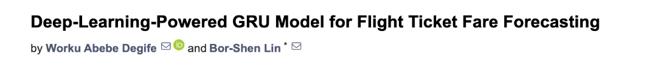
Previous solutions
Can Deep Learning add value? Better at capturing temporal dependencies in flight data? Better at generalizing?
Notes:
gated recurrent unit (GRU) (a type of RNN)

Slide 4
Datasets
Main dataset: Almost 6 million entries, US flights between 2022-04-17 and 2022-11-11
Additional datasets:
https://www.kaggle.com/datasets/iamavyukt/goibibo-flight-data (~300,000 entries, Indian flights, July-August 2023)
https://www.kaggle.com/datasets/darjand/domestic-german-air-fares (~63,000 entries, German flights, October 2019-April 2020)
Notes:
Also: https://www.kaggle.com/datasets/yashdharme36/airfare-ml-predicting-flight-fares

Slide 5
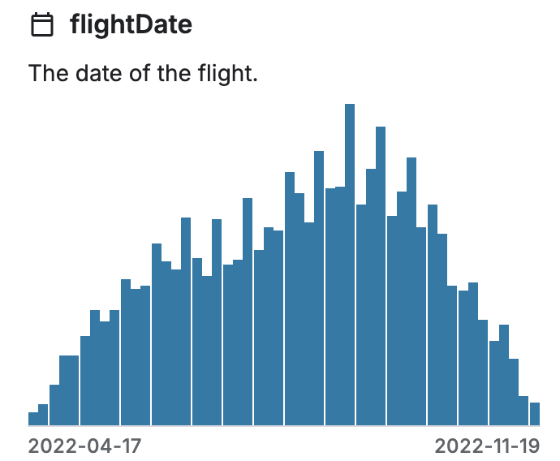
Data Visualization
Dataset Overview
dataset contains flight ticket prices from Expedia between April 17, 2022 – November 11, 2022
includes one-way flights from major U.S. airports like ATL, JFK, LAX, SFO, and more
Total Entries: 5,999,739 flight ticket records
Total Fields: 27 data attributes (destination, airline, flight duration, ticket price)

Slide 6
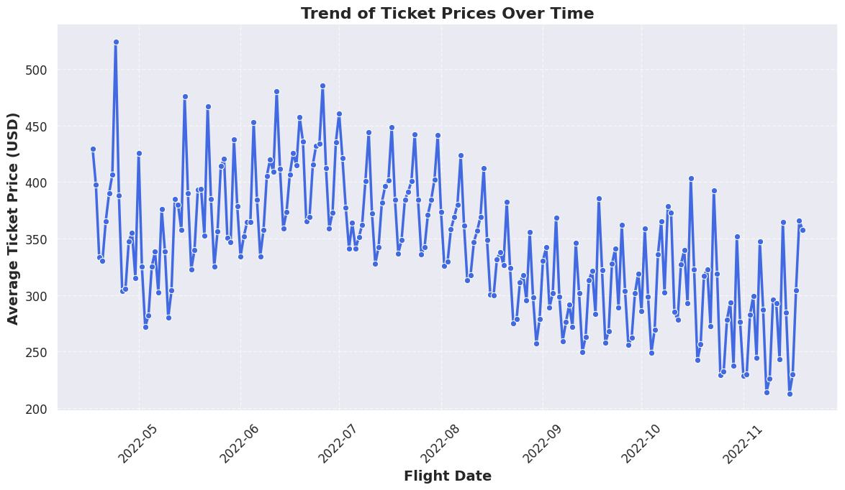
Trend of Ticket Prices Over Time

Slide 7
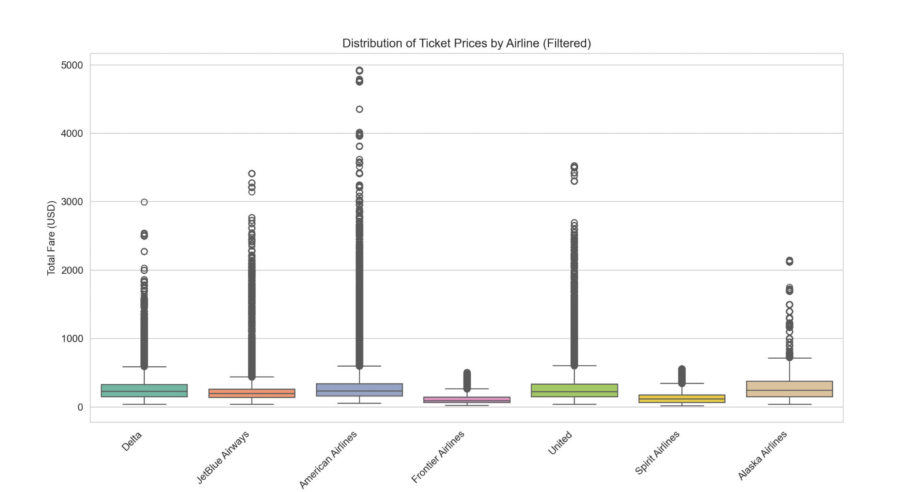
Distribution of Ticket Prices

Slide 8
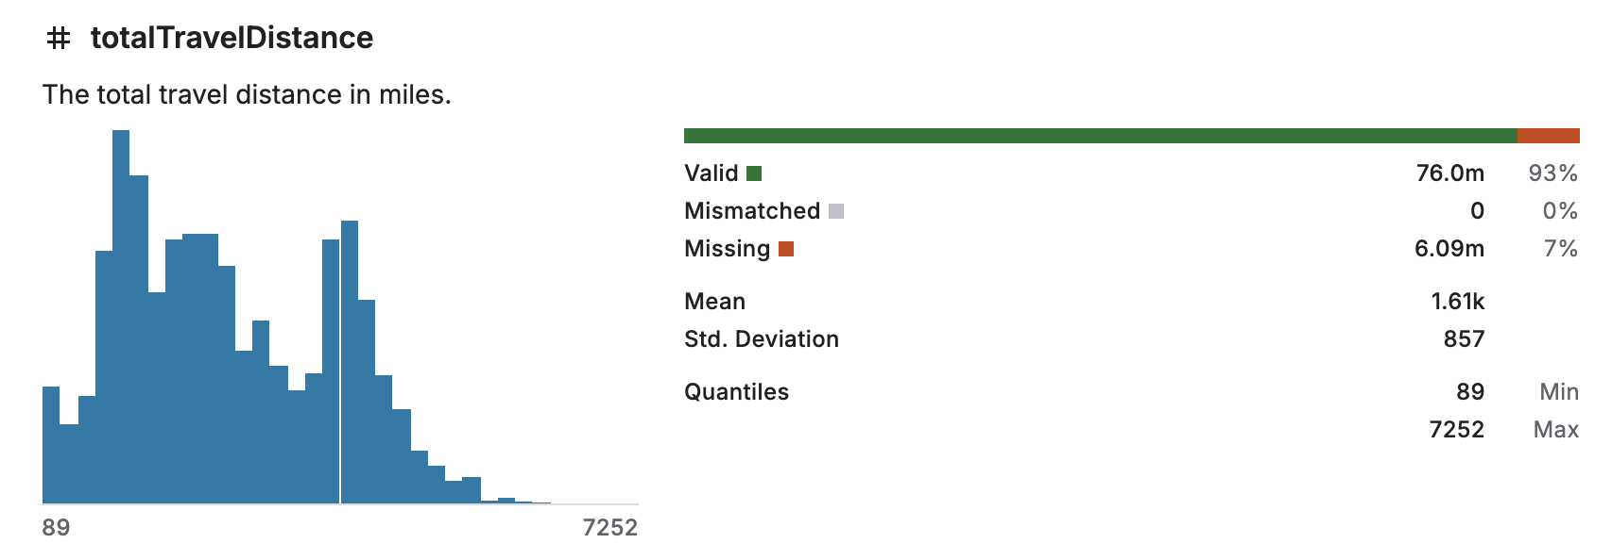
Data Cleansing
Handling Missing Data
- Entries with missing data dropped

Slide 9
Challenges
Dataset is too large to process, do not have enough memory to run the data.
Even in data preprocessing
Running everything takes 10+ minutes
Solution: use PySpark library for to work in distributed computing environment

Slide 10
Data Preparation
Feature Engineering
Converting string attribute to numerical variable
One-hot-encoding and binary encoding for categorical variables(eg. 16 airports)
Take out irrelevant/repeating columns such as ids, duplicates of cabin info
Create new columns: weekend indicator, holiday indicator
Splitting the Dataset
Train, validation, test
70%, 15%, 15%
Create Training Batches
Prepare mini batches for training

Slide 11
Future Challenges
Find a baseline to evaluate model performance.
using traditional ML
choose right model for prediction: time series forecasting (ARIMA, RNNs)
Deal with outliers:
Want to use flight datasets on other geographic locations and dates: we might meet problems in generalizing the model in non US countries and different dates.
Overfitting

Slide 12
Thank you for listening!
Questions or Suggestions?

